Slide 1
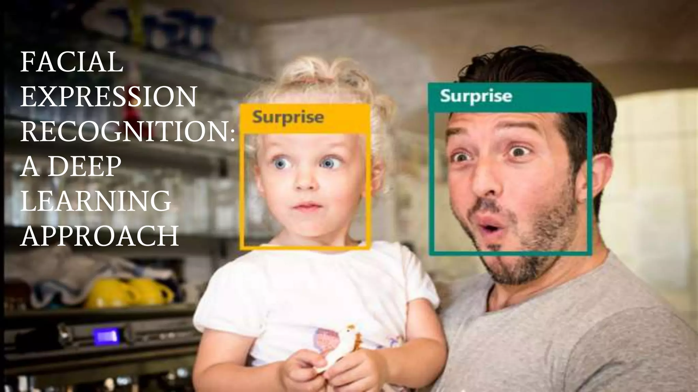

Slide 2
Facial Emotion Recognition
A deep learning approach

Slide 3
Contents
Introduction
What is Facial Emotion Recognition?
Applications of Facial Emotion Recognition
Dataset
Model Summary
Results
Conclusion

Slide 4
Emotion Recognition
Emotion Recognition: Emotion recognition refers to the ability to identify and understand human emotions based on various cues, such as facial expressions, voice tone, body language, and physiological signals.
It involves the analysis of emotional states such as happiness, sadness, anger, surprise, fear, and disgust.

Slide 5
Facial Emotion Recognition
Facial Emotion recognition specifically focuses on analyzing and interpreting emotions through facial expressions.
It involves detecting and interpreting different facial cues, such as changes in muscle movements, eyebrow position, eye gaze, mouth shape, and other facial features.
Facial expression recognition systems use computer vision techniques and machine learning algorithms to analyze and classify facial expressions into different emotional states

Slide 6
Application And Usage
Both emotion recognition and facial expression recognition have applications in various fields, including psychology, human-computer interaction, market research, entertainment, and healthcare.
They can be used to develop technologies such as affective computing systems, emotion-aware virtual assistants, emotion-driven games, emotion-based marketing strategies, and assistive technologies for individuals with autism or social communication difficulties

Slide 7
Dataset
Facial Expression Recognition Challenge 2013 (FER-2013+):
FER-2013+ is an augmented version of the original FER2013 dataset. It contains labeled facial images, including both the original FER2013 images and additional images. The emotion classes and image sizes are the same as in FER2013. Additionally
Total 58454 images belonging to 7 classes in the training set.
Total 7066 images belonging to 7 classes in the Validation set.

Slide 8
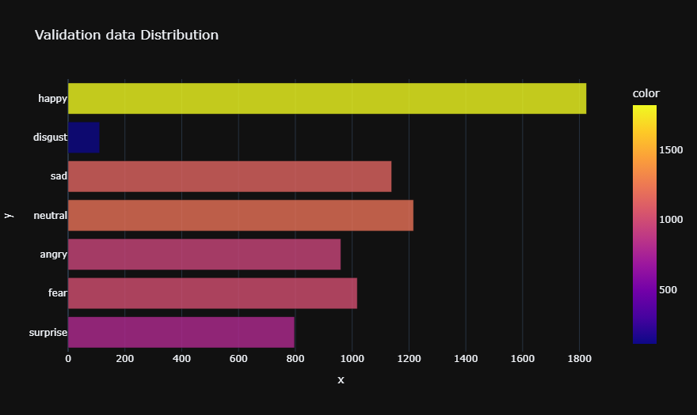
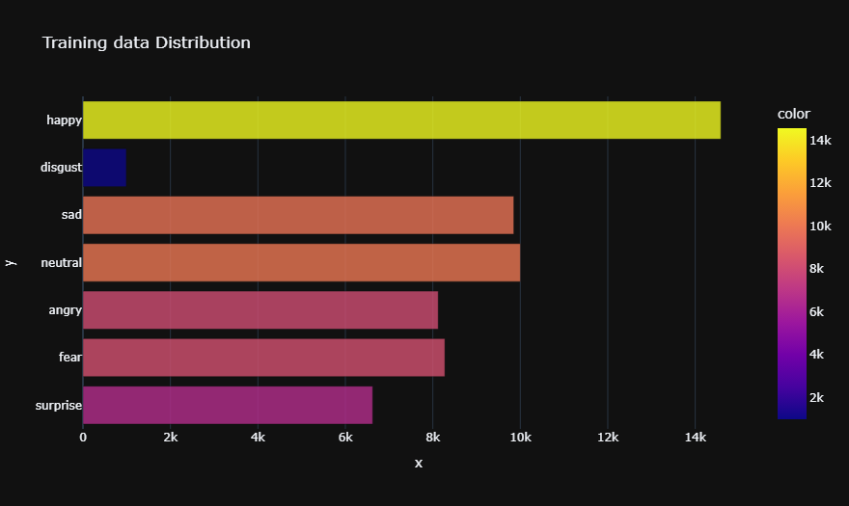
Graph For Total Numbers of emotions

Slide 9
Continued
A size of 48x48 pixels, as you mentioned, is often used as a standard size for facial expression recognition tasks. Resizing the images to a uniform size ensures consistency and compatibility when training and evaluating models on datasets like FER2013 or FER-2013+.

Slide 10
Model Summary
The provided model is a convolutional neural network (CNN) architecture for facial emotion recognition.
It consists of multiple layers, including convolutional layers with different filter sizes, batch normalization for normalization, ReLU activation for non-linearity, max pooling for down sampling, and dropout for regularization.
The model incorporates both convolutional and fully connected layers to extract relevant features from input images and perform classification.
It utilizes the Adam optimizer with a learning rate of 0.0001 and is compiled with categorical cross-entropy loss. The model summary provides a comprehensive overview of its architecture, including the number of parameters in each layer, enabling an understanding of its complexity and potential performance

Slide 11
Results
Accuracy is a commonly used metric in machine learning that measures the percentage of correctly classified samples out of the total number of samples.
The validation accuracy score of 0.88 indicates that our model achieved a classification accuracy of 88% on the evaluation data.
In the context of facial expression recognition, an accuracy of 0.88 suggests that the model performed well in identifying and classifying facial expressions with a relatively high level of accuracy.

Slide 12
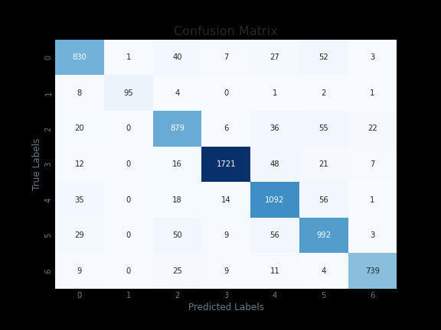
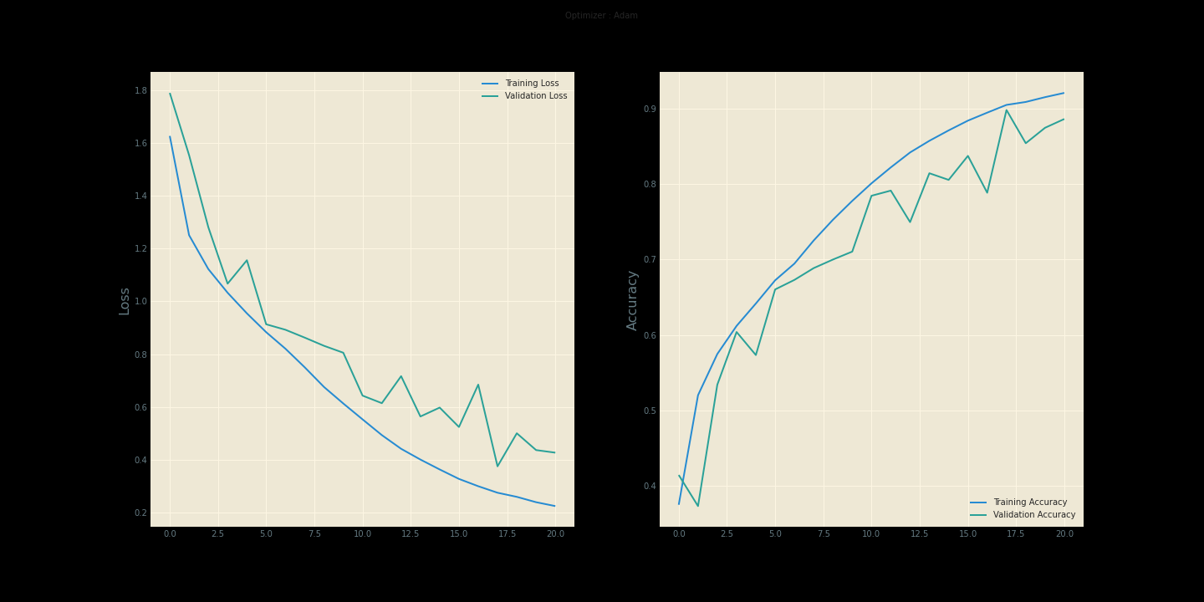
Confusion Matrix And Accuracy and loss graph

Slide 13
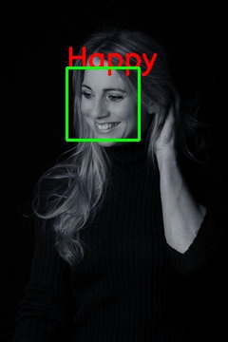
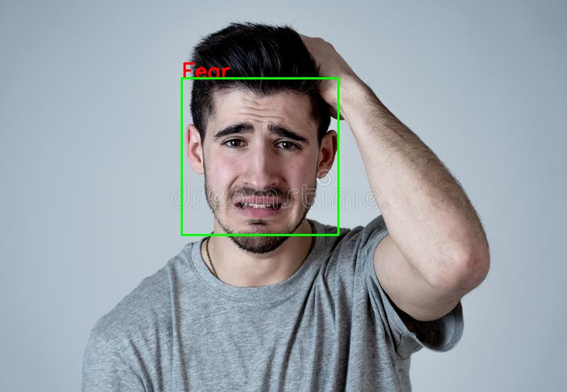
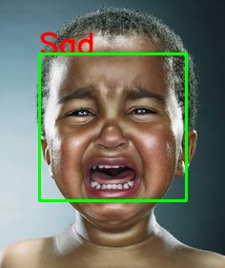
Testing Results

Slide 14
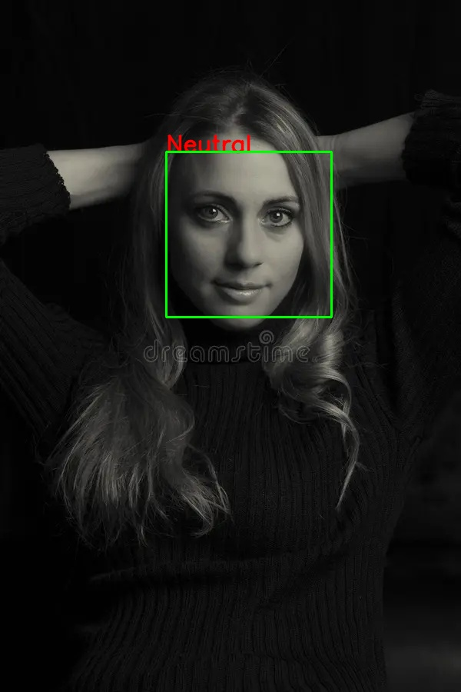
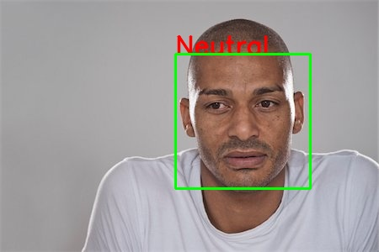
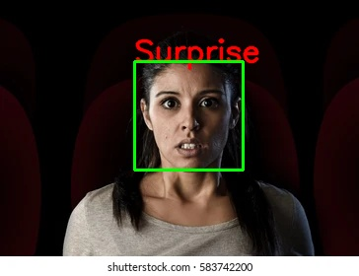
Testing Results

Slide 15
Conclusion
In conclusion, facial expression recognition is a complex technology that has the potential to revolutionize various fields such as healthcare, marketing, and security. By accurately identifying emotions, it can help doctors diagnose mental health disorders, marketers tailor their advertising campaigns, and security personnel detect potential threats.
However, there are also significant challenges and ethical implications associated with this technology. Developers must overcome technical difficulties such as lighting and pose variations, while also addressing privacy concerns and potential biases in the data used to train these systems.
Despite these challenges, the potential benefits of facial expression recognition are too great to ignore. As we continue to develop and refine this technology, it is important for us to approach it with thoughtfulness and consideration for its impact on society.

